Slide 1
Planetary Science and Ecosystems
Jordan Stone
Credit: Ittiz/Wikimedia Commons
Notes:
Introduce yourself
Structure
Planetary science helps Earth (Atmospheres, Geology, Oceans, Exoplanets)
Bring it together (Gaia hypothesis, terraforming, geoengineering)

Slide 2
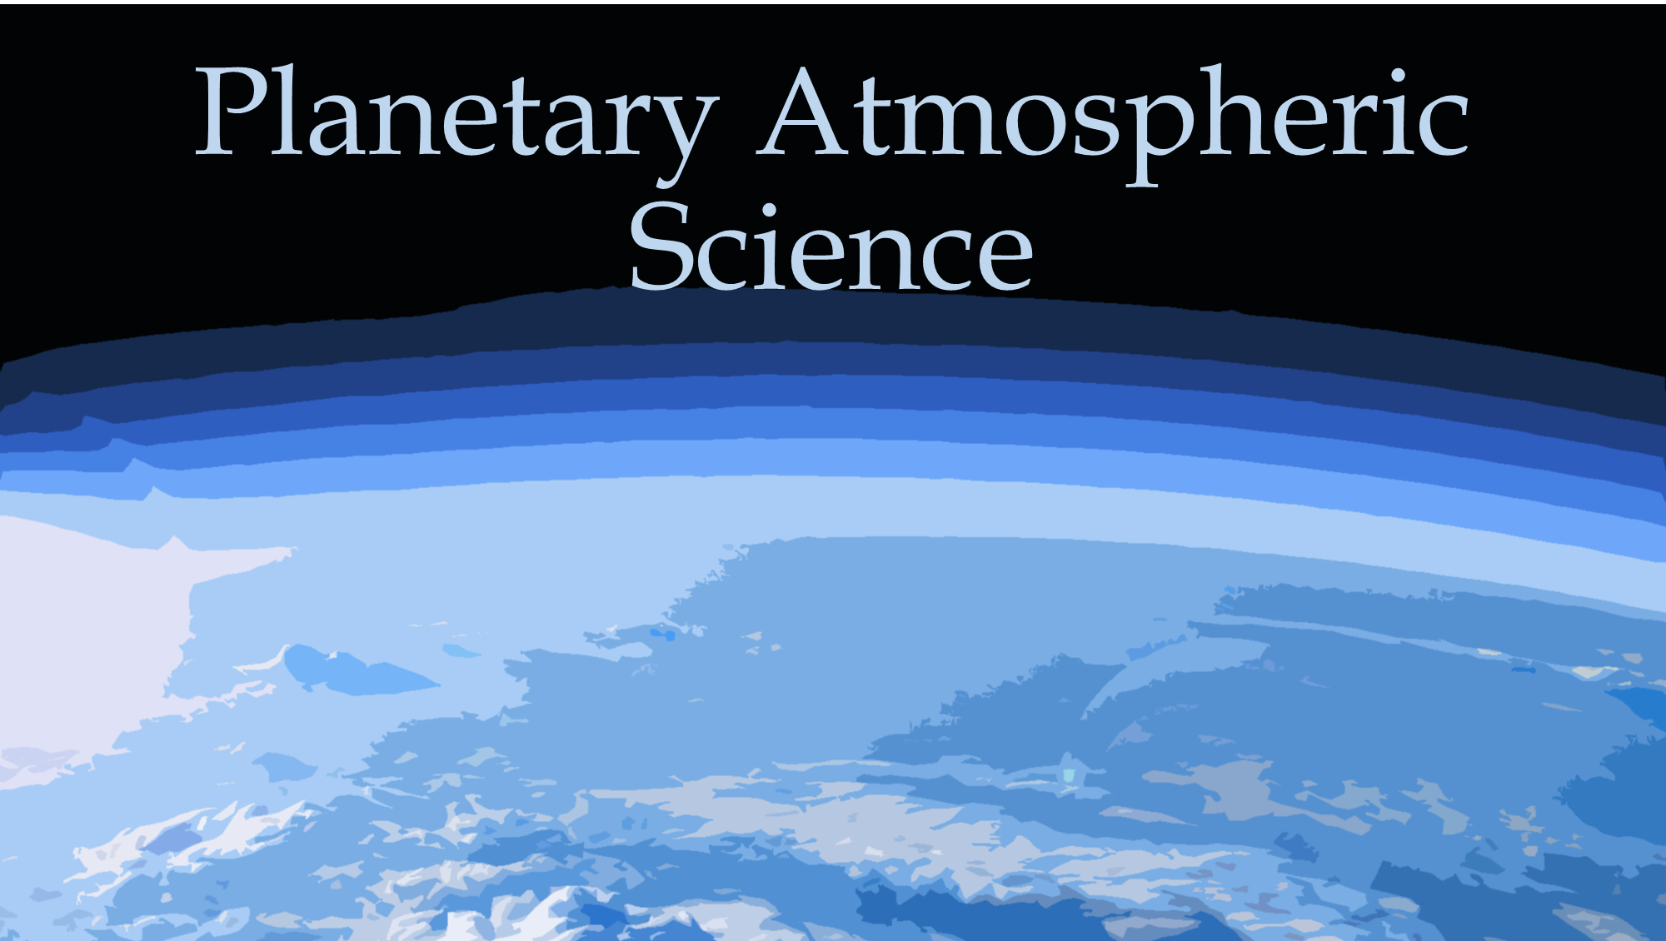
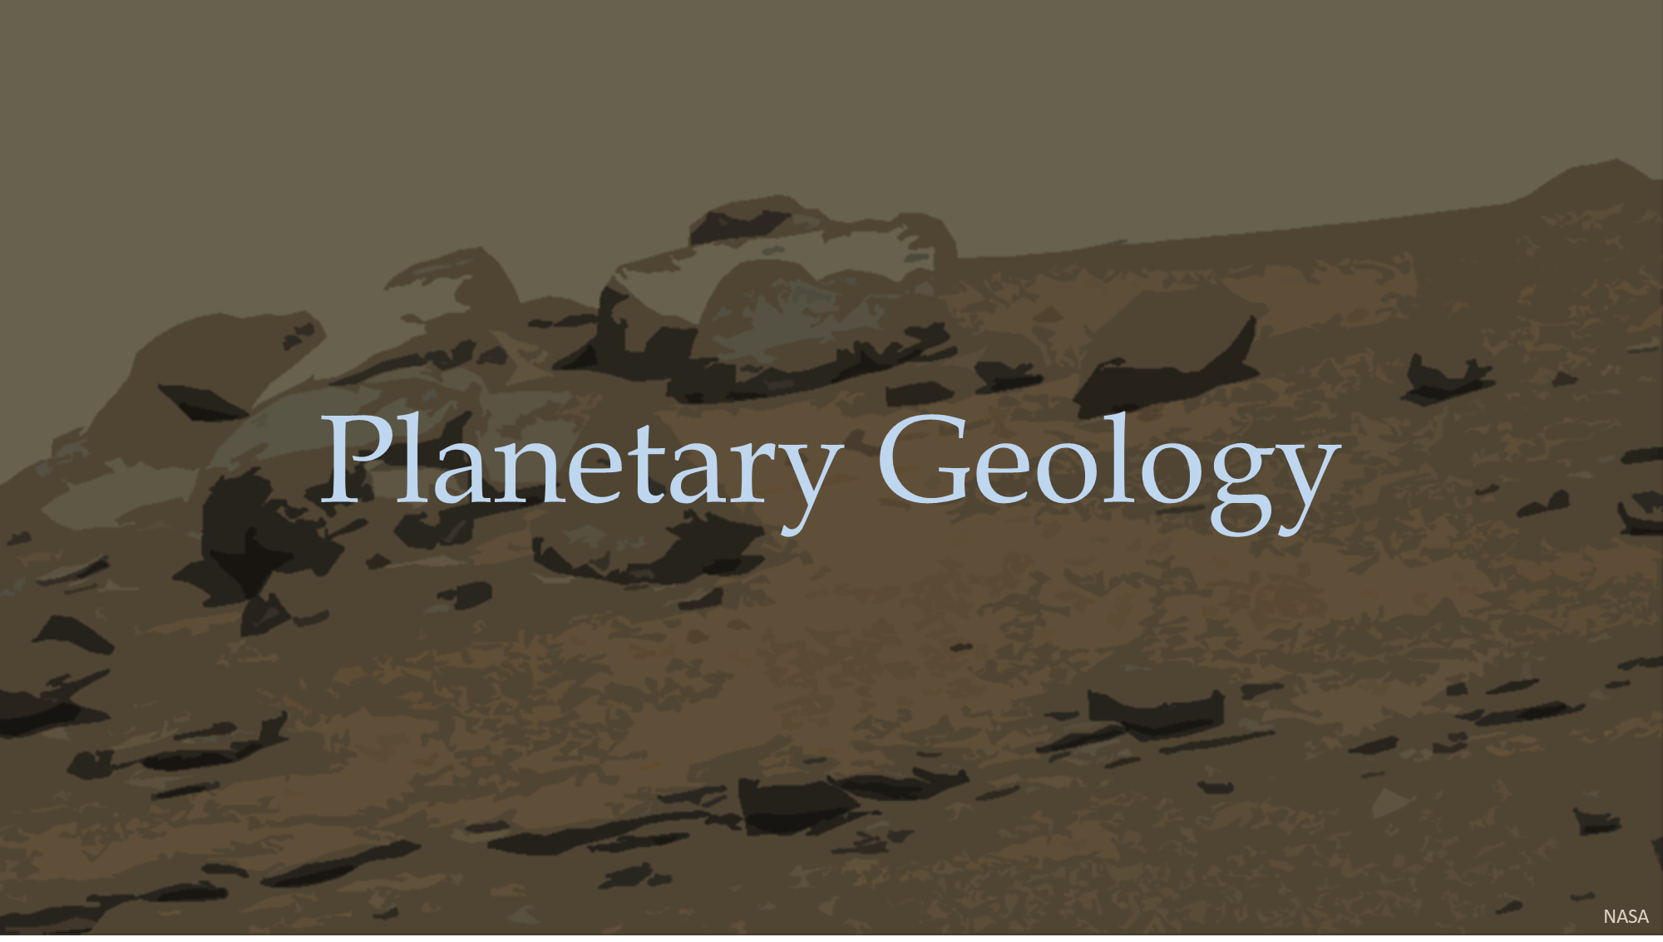
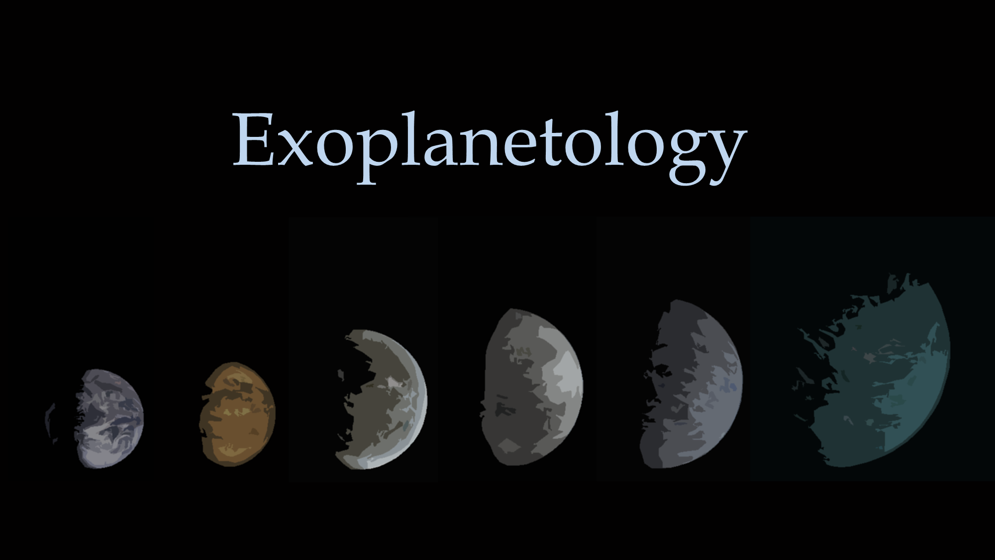
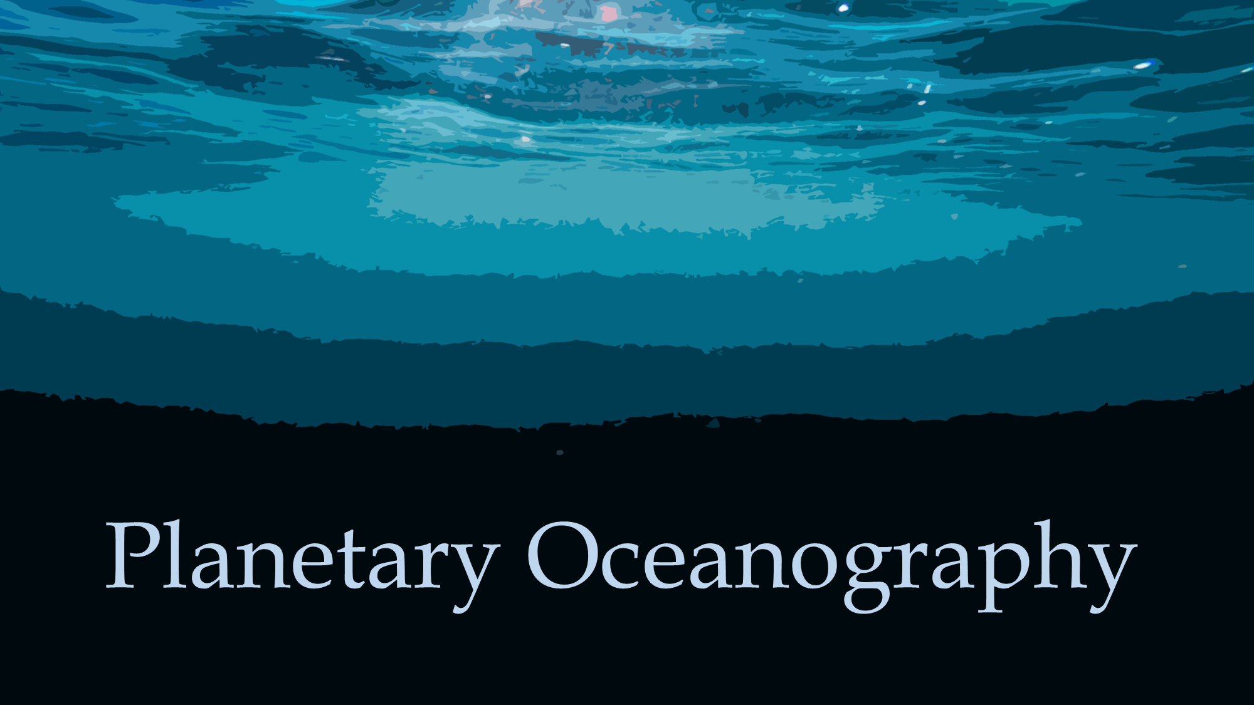
Planetary Science
Notes:
Comes from astronomy and earth sciences
Includes Earth
Telescopes and rovers for other planets.
Labwork
Computer simulations
Fieldwork to extreme environments
Atmospheres
Phosphine on Venus was two radio telescopes on the ground
Planetary Geology
Geomorphology, cosmochemistry, geochemistry, petrology, geophysics
Rovers
Meteorites
Exoplanetology
Telescopes based in space. Like JWST

Slide 3
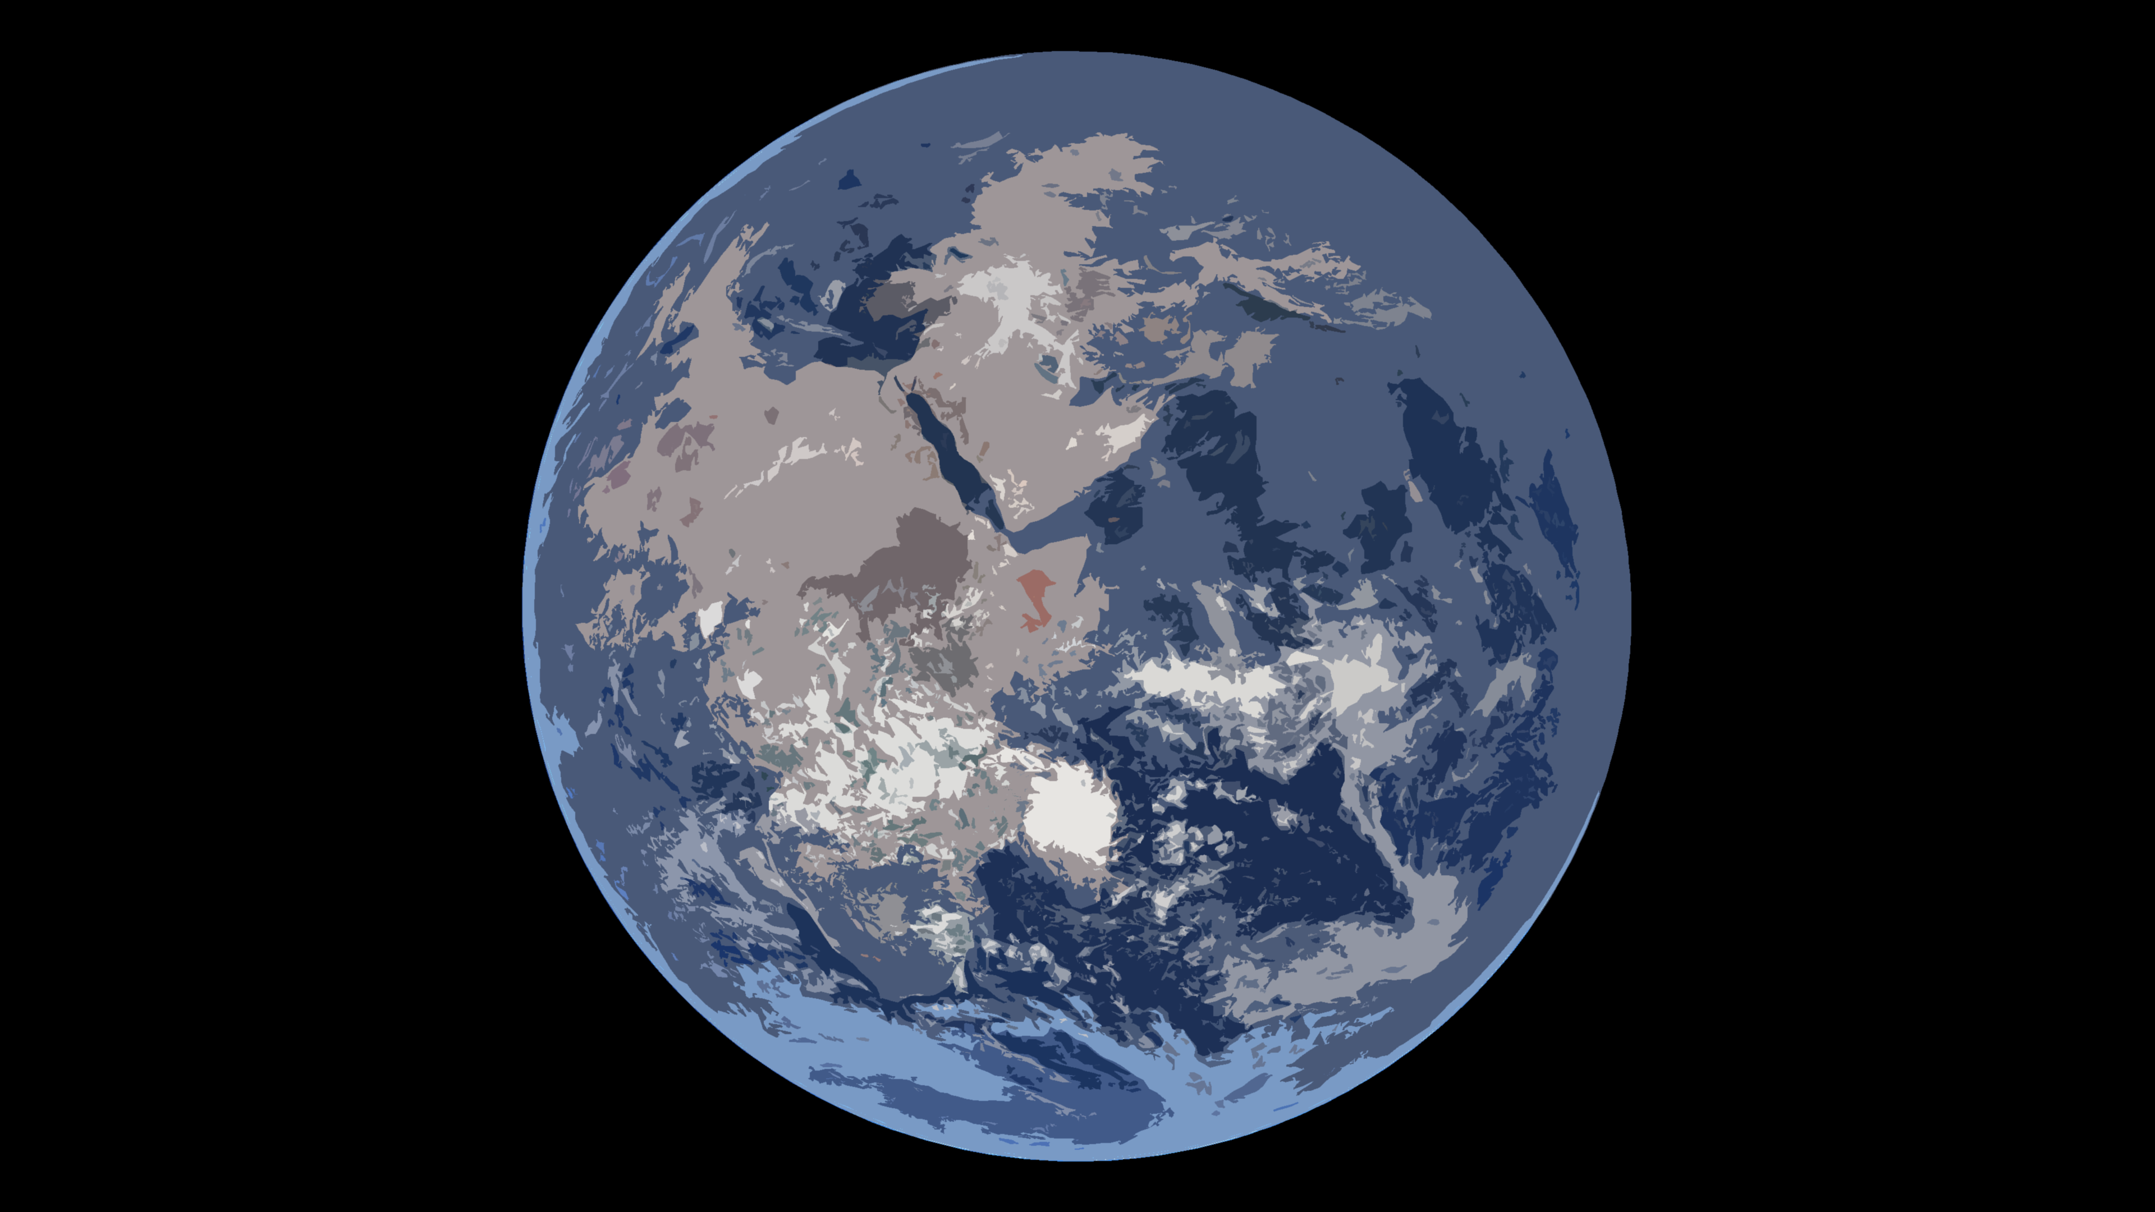
The Global Ecosystem (Biosphere)
Atmosphere
Magnetic Field
Greenhouse effect
Oxygenated
Ozone layer
CO₂
N₂
Within habitable zone
Liquid water
Rocky planet
Stable axial tilt
Notes:
Planetary science & ecosystems seems like a weird topic
Planetary science is already linked to ecosystems
Stable axial tilt – stable climate

Slide 4
Comparative Planetary Science
Venus
Earth
6,052 km
6,371 km
Moon
464 °C
13.9 °C
Notes:
We used to only use Earth’s present to understand past and future. Until planetary science
We have a really big moon (1/4 the size of Earth).

Slide 5
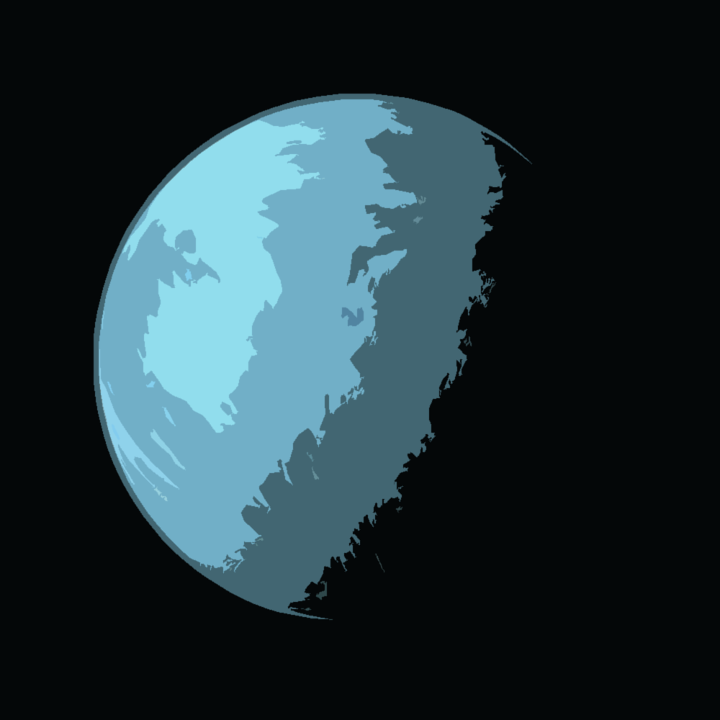
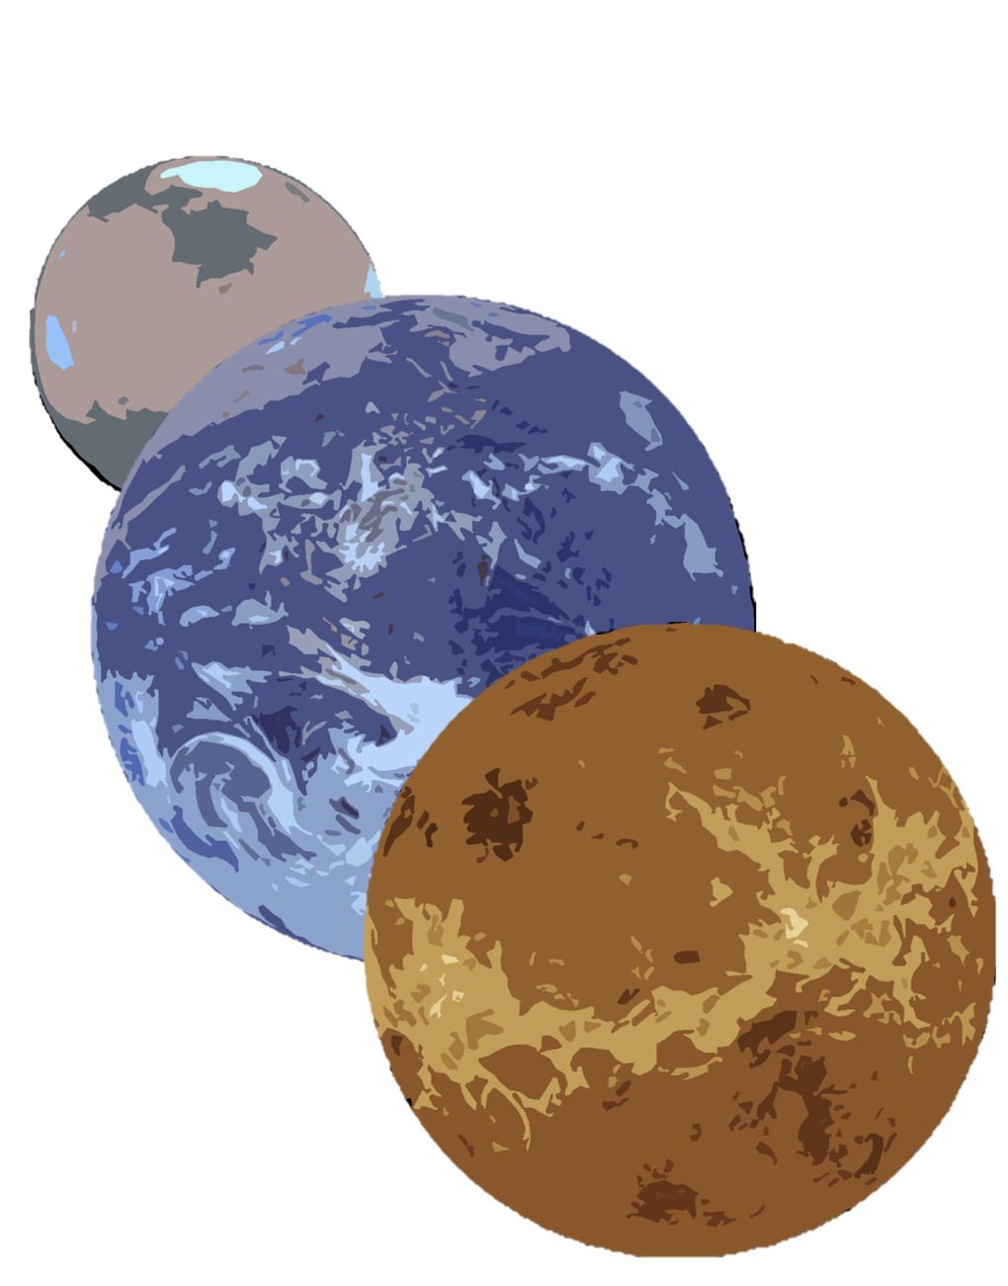
The Value of Earth in Planetary Science
ESA
Searching for habitable exoplanets
Understanding our solar system
Searching for life in our solar system
Notes:
Before I go into the value of planetary science for understanding Earth
The rocky planets formed from the same material, the same protoplanetary disk. By comparing the material on Earth with Venus and Mars, we can see what the other planets lost.

Slide 6
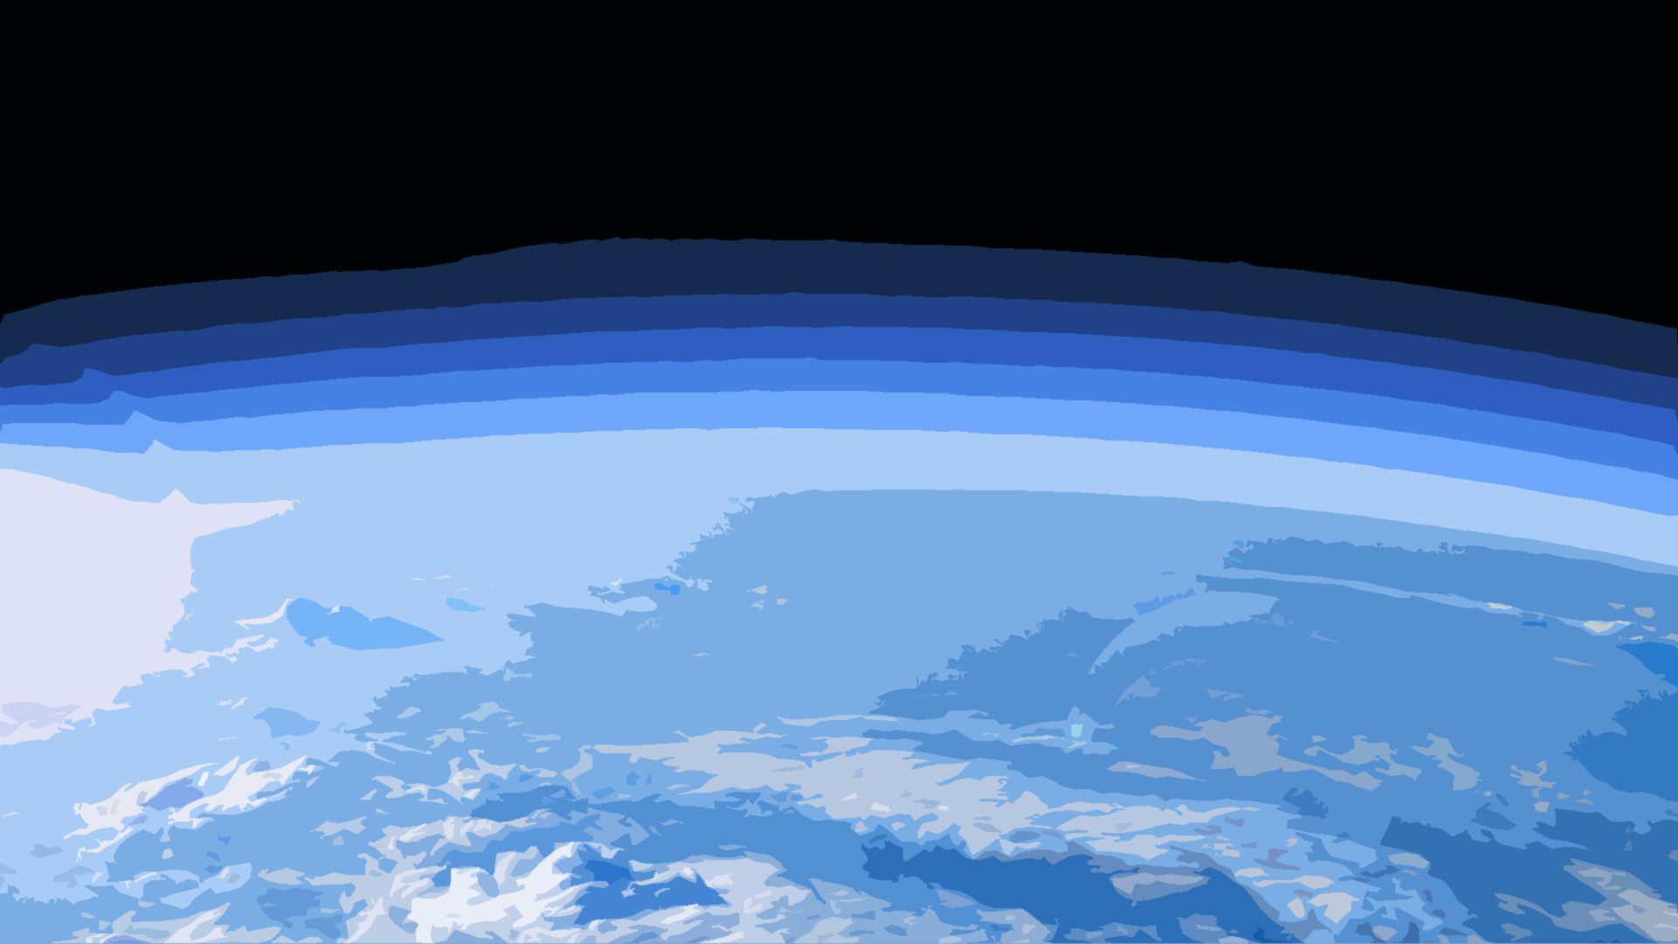
Planetary Atmospheric Science
Notes:
First of 4

Slide 7
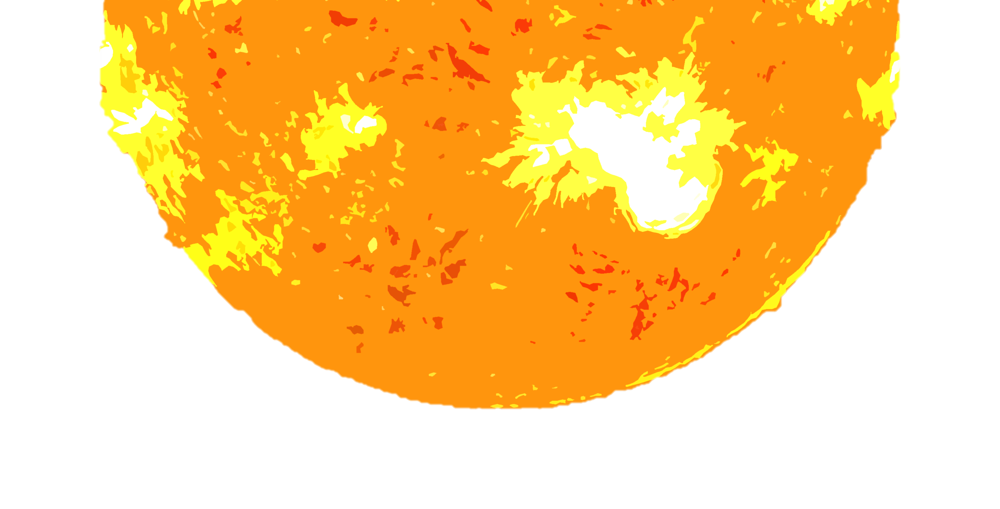
The Venus Runaway Greenhouse Effect
Ingersoll, A. P. 1969. The runaway greenhouse: A history of water on Venus. Journal of Atmospheric Sciences, 26, 1191-1198.
Water vapour
Solar Radiation
Oceans
Venus
Notes:
464 °C

Slide 8
Runaway Greenhouse and Climate Crisis
1. Could the runaway greenhouse effect occur on Earth?
BuT wHaT abOUt iN an BiLLiOn YeArs?
2005:
“[there] is no possibility of [Venus's] runaway greenhouse conditions occurring on the Earth”
- James Houghton
2009:
“'runaway greenhouse effect'—analogous to Venus—appears to have virtually no chance of being induced by anthropogenic activities.”
- IPCC
2010:
“if we burn all reserves of oil, gas and coal, there is a substantial chance that we will initiate the runaway greenhouse. If we also burn the tar sands and tar shale, I believe the Venus syndrome is a dead certainty”
- James Hansen
2013:
James no. 2 you need like 10x the amount of CO₂ that you thought to make a runaway greenhouse so stop being so dramatic
- Robert Kunzig
Notes:
Explain how it could occur on Earth first
The ultimate climate emergency

Slide 9
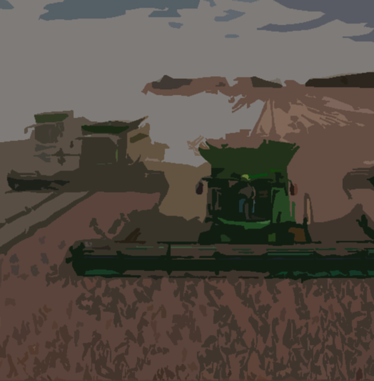
Runaway Greenhouse and Climate Crisis
2. Smaller positive feedback loops
James Hansen, a prominent climate scientist has said “if we burn all reserves of oil, gas and coal, there is a substantial chance that we will initiate the runaway greenhouse. If we also burn the tar sands and tar shale, I believe the Venus syndrome is a dead certainty” (Hansen 2010).
Carbon dioxide and methane in permafrost
Ocean carbon dioxide absorption
Intensity of Agriculture
Ice albedo
Jeff Vanuga/Getty
www.deere.com
Ian Joughin/IMBIE
(Schädel et al., 2016)
(Bajželj and Richards, 2014)
(Le Quéré et al., 2010)
(Fraedrich, 1979)
BAJŽELJ, B. & RICHARDS, K. S. 2014. The positive feedback loop between the impacts of climate change and agricultural expansion and relocation. Land, 3, 898-916.
FRAEDRICH, K. 1979. Catastrophes and resilience of a zero‐dimensional climate system with ice‐albedo and greenhouse feedback. Quarterly Journal of the Royal Meteorological Society, 105, 147-167.
LE QUÉRÉ, C., TAKAHASHI, T., BUITENHUIS, E. T., RÖDENBECK, C. & SUTHERLAND, S. C. 2010. Impact of climate change and variability on the global oceanic sink of CO2. Global Biogeochemical Cycles, 24.
SCHÄDEL, C., BADER, M. K.-F., SCHUUR, E. A., BIASI, C., BRACHO, R., ČAPEK, P., DE BAETS, S., DIÁKOVÁ, K., ERNAKOVICH, J. & ESTOP-ARAGONES, C. 2016. Potential carbon emissions dominated by carbon dioxide from thawed permafrost soils. Nature climate change, 6, 950-953.
Notes:
Oceans absorb ½ of Humans’ CO2. Oceans are outgassing CO2

Slide 10
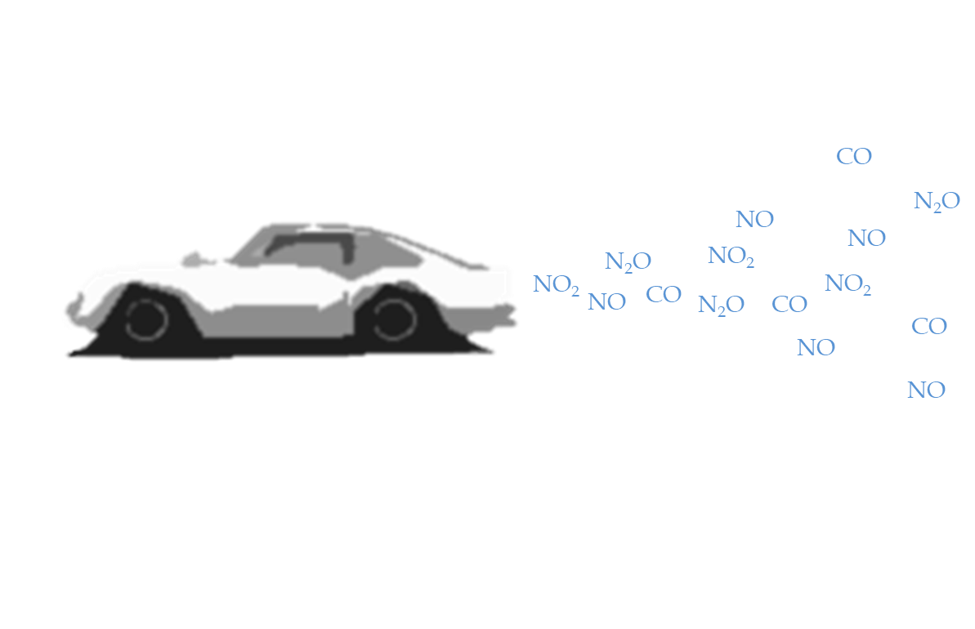
Reducing air pollution
N₂
N₂O
Cosmic dust-like iron silicate powder
H₂O
CO
CO₂
N₂O
N₂
H₂O
CO
CO₂
Notes:
Alexander James at the University of Leeds is designing catalytic converters based on the chemical reactions seen on Venus and other hot planets

Slide 11
Titan
Early Earth had no ozone layer
Geoengineering?
Haze layer
NASA/JPL
Antigreenhouse effect
MCKAY, C. P., POLLACK, J. B. & COURTIN, R. 1991. The greenhouse and antigreenhouse effects on Titan. Science, 253, 1118-1121.
Notes:
Titan is an analogue for the very early Earth. It has rivers lakes and seas
Haze is mostly made of aerosols. (from methane and hydrogen)
-179 °C

Slide 12
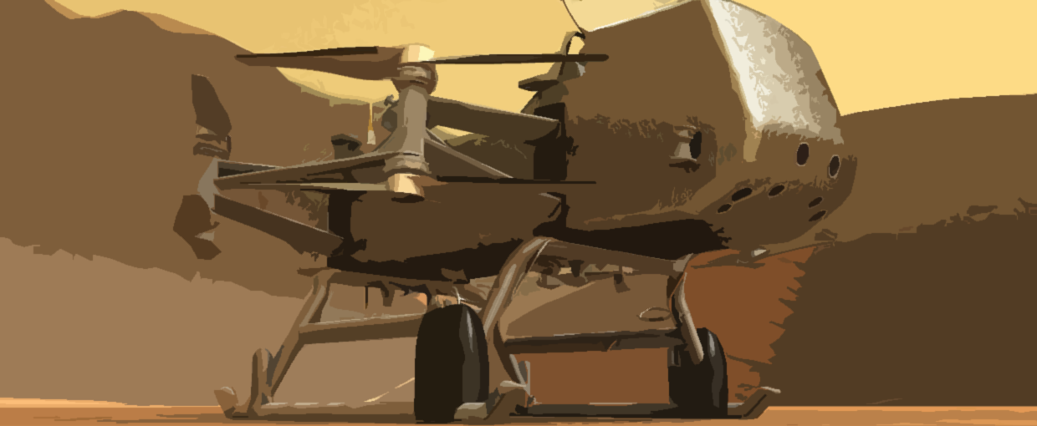
Future discoveries from atmospheric sciences
The atmospheres of exoplanets
Dragonfly mission to Titan will teach us more about its atmosphere
NASA
Notes:
James Webb last week

Slide 13
Planetary Geology
Discover new chemical reactions
Separating Chemistry from life
Test our models
Provide new context
Our Habitable Planet
NASA

Slide 14
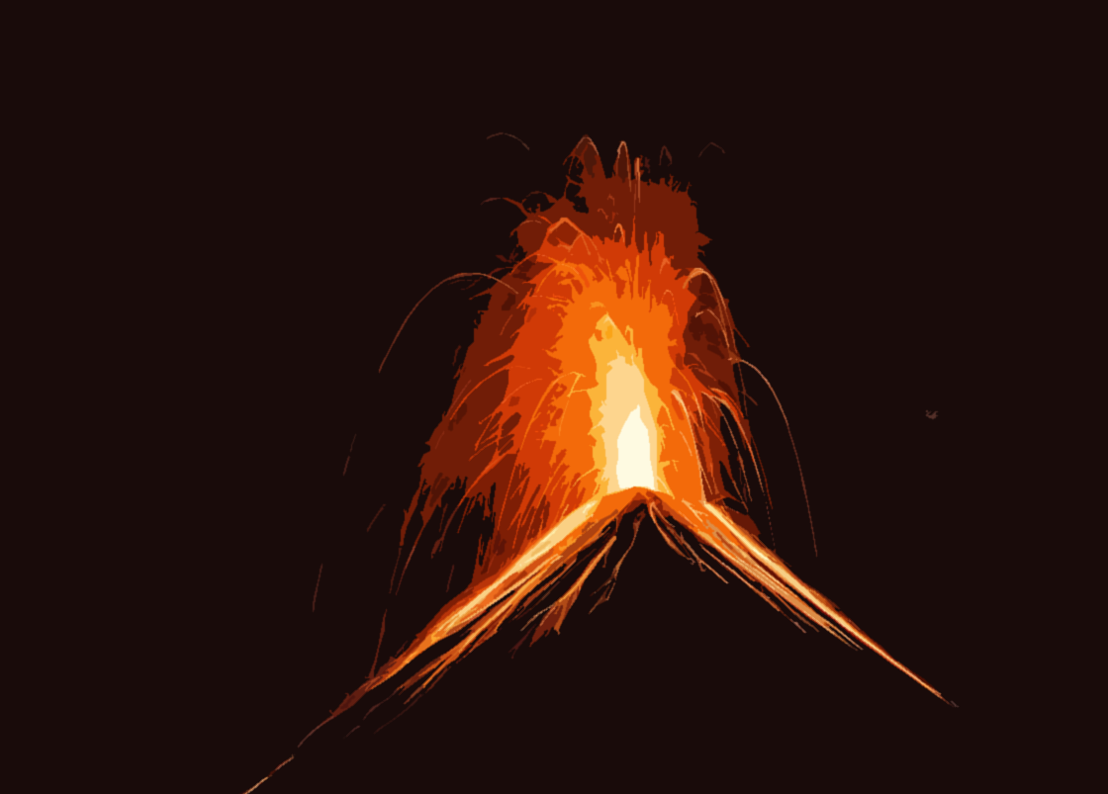
New chemical reactions
Venus sulphur chemistry…
…helps us understand volcanoes on Earth
Notes:
Many types of sulphur compounds on Venus including sulphuric acid
They all form from sulphur in the atmosphere
Venus is also just really hot
Saying we’ve mastered chemistry by just studying Earth is like saying you’ve mastered cooking without ever having heard of Italy

Slide 15
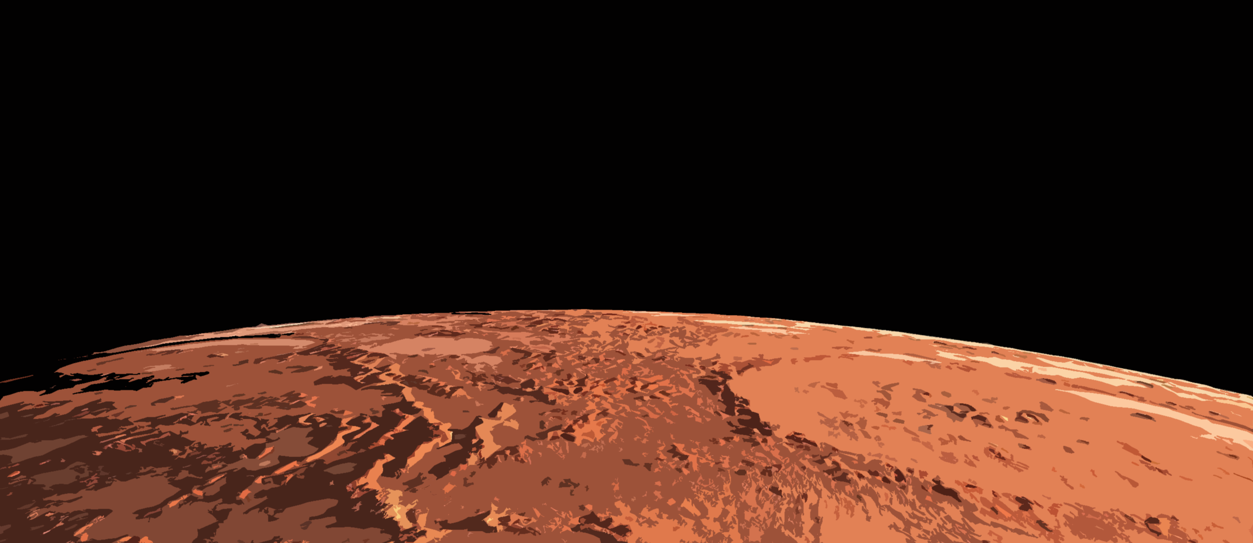
Separating chemistry from life
Methane
Amino acids
Hydrocarbons & organic molecules
Methane
CH₄
CH₄
CH₄
CH₄
Notes:
Titan has liquid methane oceans and methane in the atmosphere

Slide 16
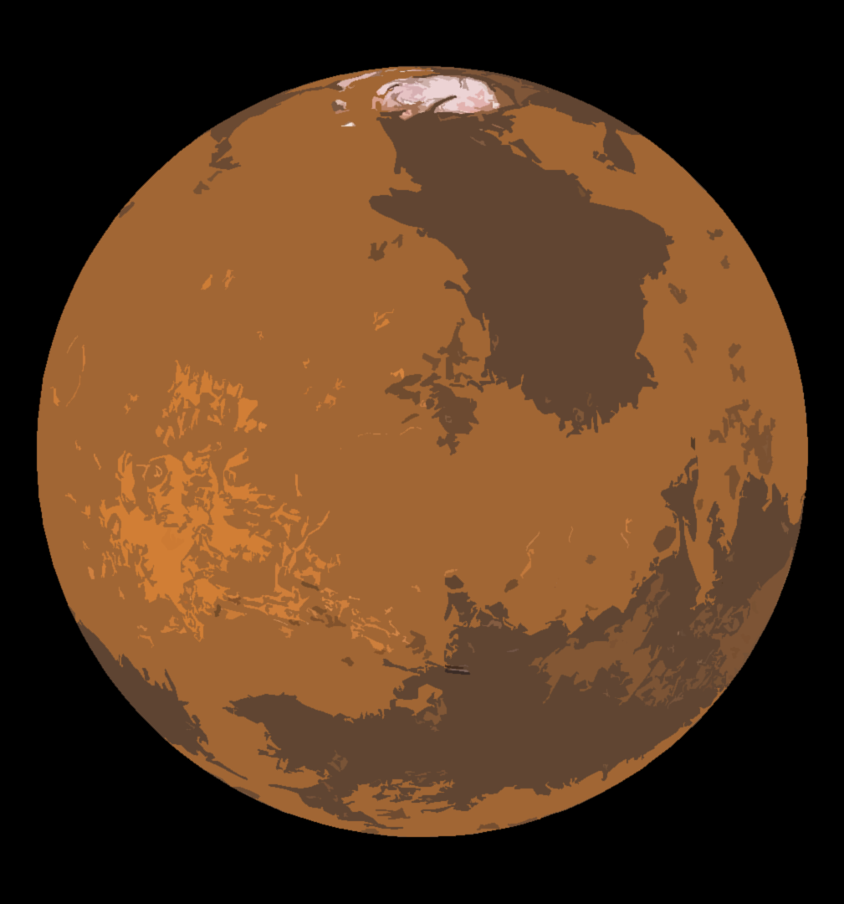
Test our models
Lapotre, MáGA, et al. "Large wind ripples on Mars: A record of atmospheric evolution." Science 353.6294 (2016): 55-58.
Water density
A 3rd ripple type???
Ripple size
Notes:
Test our models by inputting new scenarios to test the models with
Curiosity discovered new ripples at Gale crater that don’t exist on Earth
Scientists at Caltech revised models
Discovered relationship between ripple size and water density
Used these new models on early Earth
Now can draw conclusions about salinity and temperature of ancient water

Slide 17
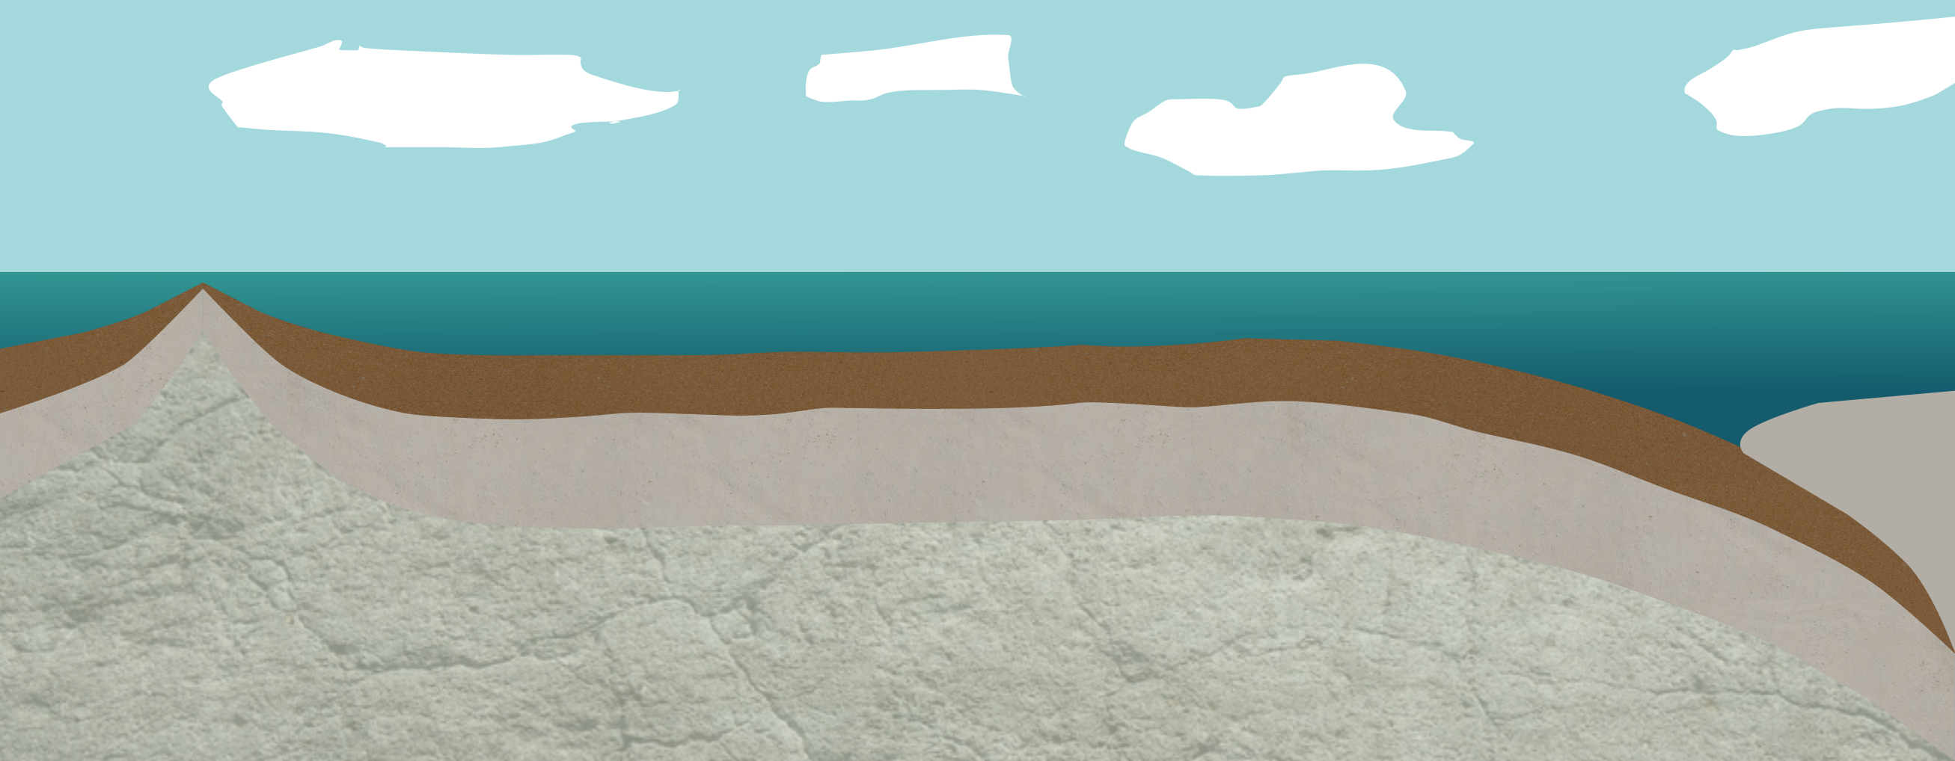
Our habitable planet
Giant Impact
(pretty much)
No Magnetic Field
Dead Iron-core Dynamo
Thin Atmosphere
Notes:
By looking at other planets and why they are not habitable, we can understand why our own is.

Slide 18
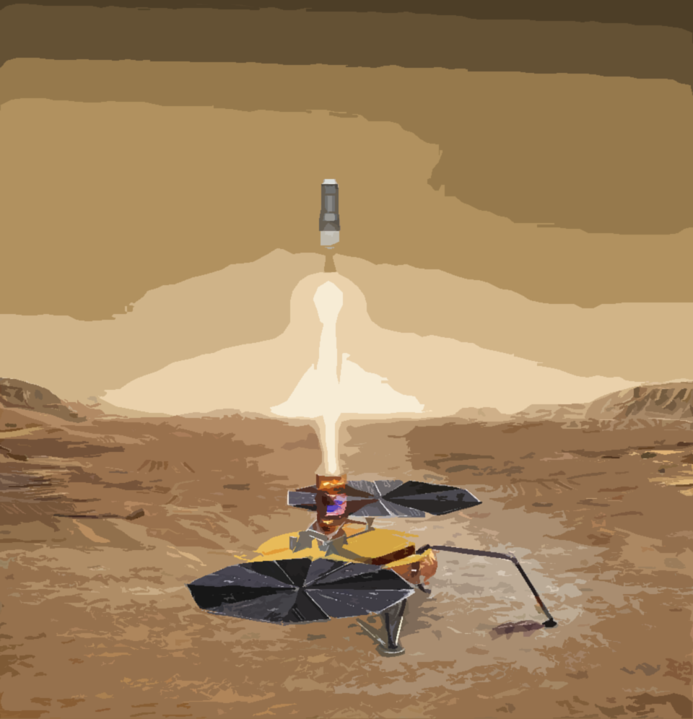
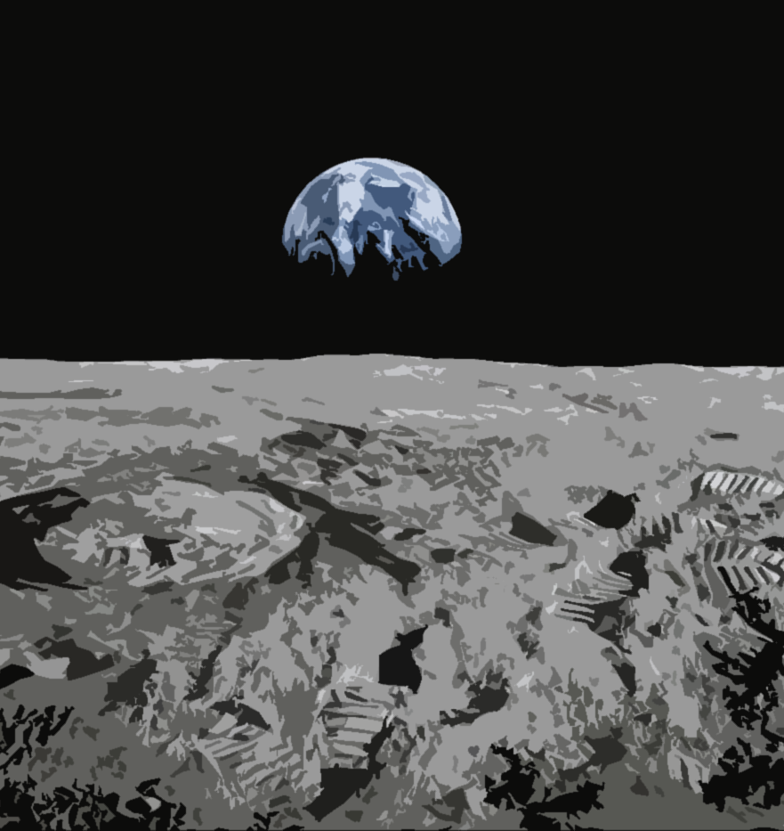
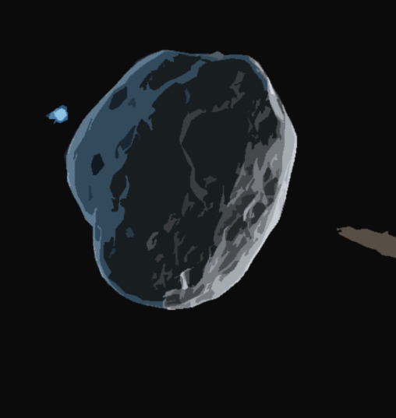
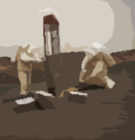
Future of Planetary Geology
Mars sample return
Humans 2 Mars
Back to the moon
Asteroid mining
NASA/JPL
Alec Woods
Notes:
Asteroid mining could get us rare materials to use for creating solar panels etc.

Slide 19
Planetary Oceanography

Slide 20
Venus and Mars
Venus and Mars may have had oceans
BUT THEY’RE GONE!
Notes:
It’s mostly a one way street at the moment while we try to decipher what these oceans were actually like on Venus and Mars based on what we know about Earth.
At least it tells us how special our oceans are

Slide 21
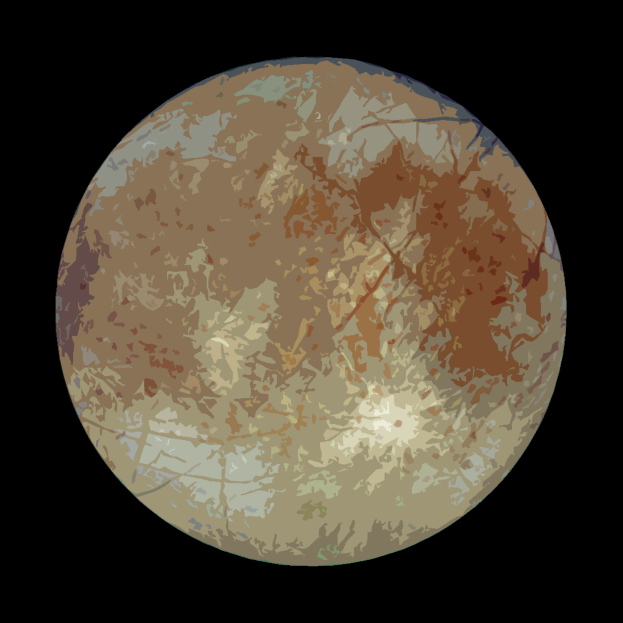
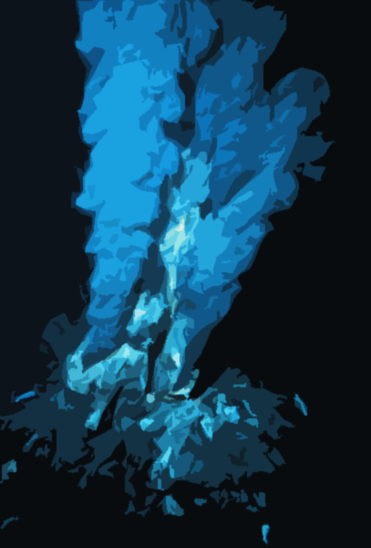
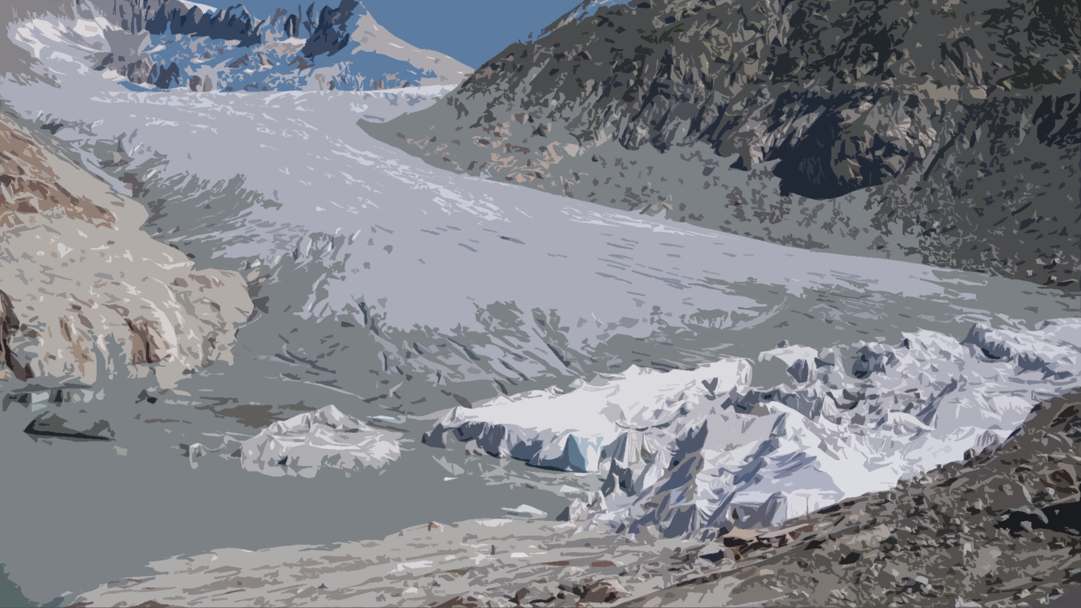
We are curious about whether life can survive in subsurface oceans of icy moons…
…which has driven research into fascinating environments on Earth

Slide 22
Notes:
Titan is the only other planet with standing liquid lakes, rivers and seas

Slide 23
Exoplanetology
Notes:
And, of course, there are potentially oceans on exoplanets

Slide 24
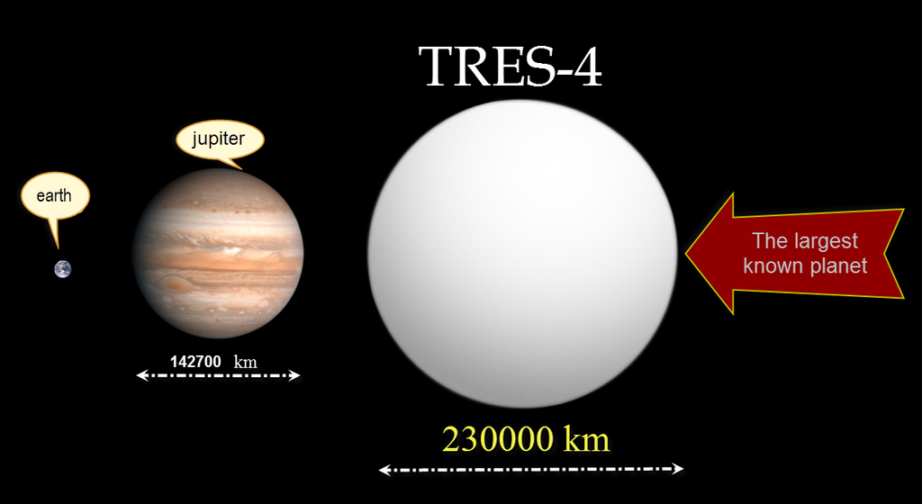
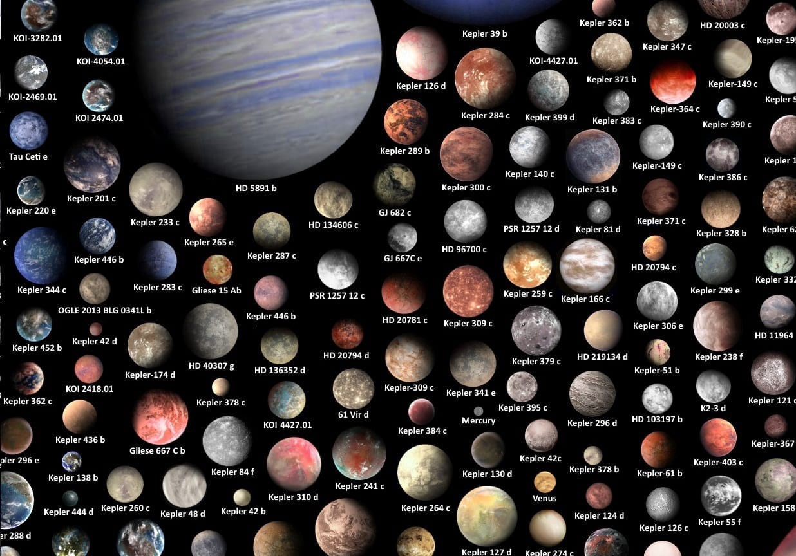
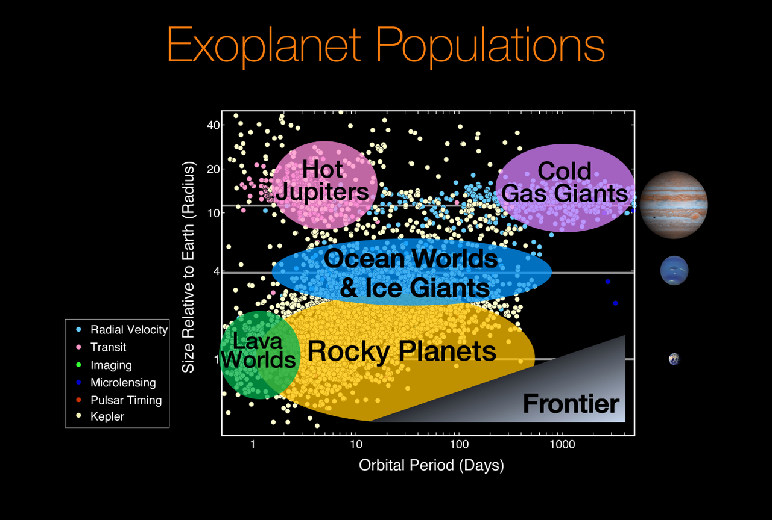
Context for Earth
How big is Earth from a universe perspective?
Notes:
Size
Distance from star
Types of planets and their abundances
Different types of stars

Slide 25
Earth is special
Lots of potentially habitable planets
But no aliens?!
Notes:
Fermi paradox
300 million potentially habitable planets in our galaxy. Based on research from kepler data – Jeff Coughlin at SETI
Origin of life
Great filter.
Perspective shift

Slide 26
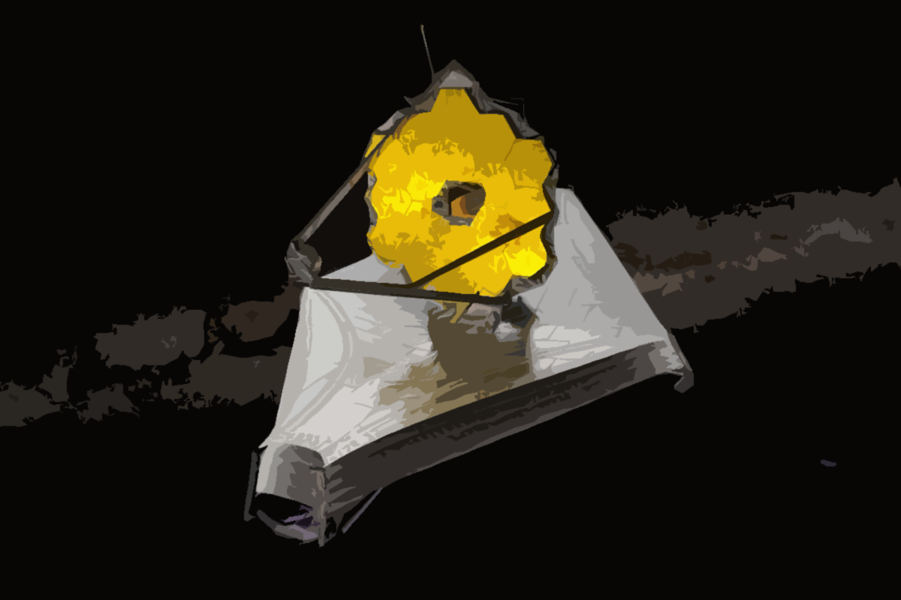
Future of exoplanets
First CO₂ discovered in the atmosphere of an exoplanet last week
First new exoplanet discovered 3 days ago
Notes:
The runaway greenhouse on Venus is just one example of a mechanism that can lead to a loss of habitability.

Slide 27
Planetary Science
Notes:
Planetary science teaches us about climate change
Planetary geology teaches us new chemistry and why our planet is habitable
Planetary oceanography

Slide 28
The Gaia hypothesis
Temperature management
13.9 °C
Oxygenated atmosphere
Stable salinity
Notes:
Sun luminosity has been increasing but Earth remained habitable through all of it.
In the early earth, methanogens produced methane to heat up the planet during the faint young sun.
Nowadays, processing of CO2 by plants reduces the concentration of CO2 in the atmosphere

Slide 29
Terraforming (or planetary ecosynthesis)
Melted permafrost
Artificial Magnetic Field
Oxygenated atmosphere
Supergreenhouse gases
Notes:
Terraforming is currently undergoing a bit of a revolution.

Slide 30
Why Mars and Venus are not habitable
Geoengineering
Thick CO₂ Atmosphere
Thin Atmosphere
Mars
Earth
Venus
A stable greenhouse effect is really really important
Strength of greenhouse effect
Notes:
Mars is not habitable because its greenhouse effect doesn’t work anymore. It lost its atmosphere to the solar wind so its too thin to retain heat. That’s why its cold and has no water.
Venus has the opposite problem, where the greenhouse effect is too strong, and now the surface melts lead.

Slide 31
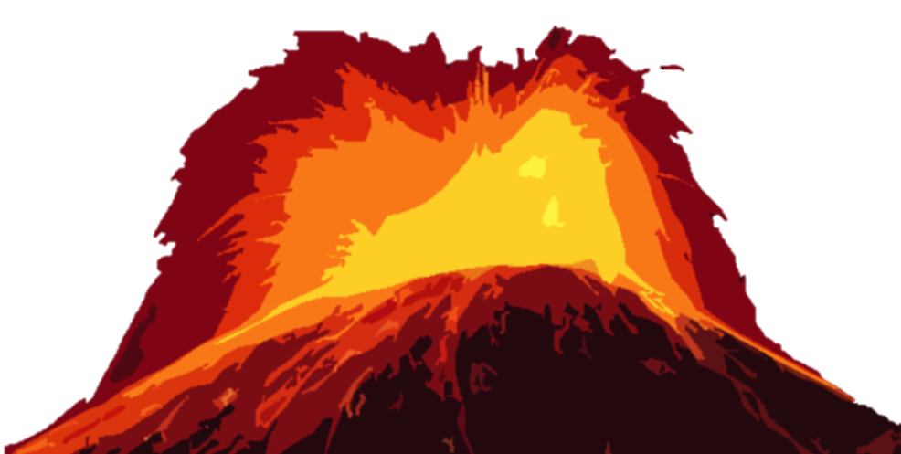
Geoengineering
What are aerosols?
Effects:
Temporary
Moderate
Responsive
What else could happen?
Some aerosols heat up the planet
Some aerosols cool down the planet
Mirrors in space
Increasing surface reflectivity
Carbon capture
Afforestation
etc.
Keith, D. W. & MacMartin, D. G. A temporary, moderate and responsive scenario for solar geoengineering. Nat. Clim. Change 5, 201–206 (2015).
Notes:
Some aerosols cool the planet and others heat it up. James Hansen thought that Venus’ hot temperatures are due to aerosols in the atmosphere. 60s.
Mt. Pinatubo in Philippines
1991
1.2 square miles of tiny, reflective rock particles into the high stratosphere
cooling the planet for two full years afterward.
What chemical reactions could occur in the atmosphere that might change one to another?
Using aerosols just delays the problem of reducing our emissions

Slide 32
Long term future
Notes:
Billions of years.
I’ll explain why it might be something to consider now

Slide 33
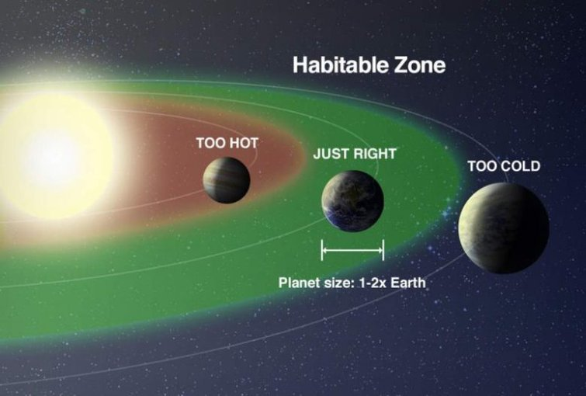
The Inevitable Doom of all Life on Earth
1-3 billion years time
Move to Mars or Titan?
Send life to other planets now?
Notes:
10% brighter about one billion years
Our ability to send life to other worlds may be coming to a close. AI, bioweapons, nuclear weapons, nanotechnology, climate change

Slide 34
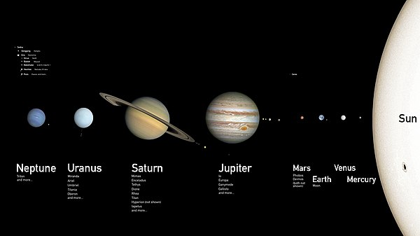
Habitability and future life
Notes:
Planetary science creates a map of the most habitable planets in our solar system.
This could help us seed new planets with life in the future if we want to

Slide 35
Conclusions
Planetary science is very valuable for understanding Earth
Future discoveries from planetary science will teach us more
Combining ecosystems and planetary science gives us interesting theories and ideas – but there is a lot to think about
Notes:
Especially Venus. Greenhouse, plate tectonics. Titan as an analogue for understanding the early Earth
Mars sample return will teach us about the history of life. Many future probe missions to Venus planned, and the dragonfly mission to Titan. Exoplanet atmospheres.
All discoveries ive mentioned have been spin offs, maybe we should have more missions with dedicated instruments to help us understand Earth.
Gaia hypothesis. Terraforming other planets. Geoengineering

Slide 36
